Slide 1

Presentation
IE 5331 – Data Science for Technical Managers
Fall 2022
Prepared for:
Dr. Daniel A. McGrath
Prepared by:
Md Ariful Haque Miah (R#11636945)

Slide 2
Covid-19 vaccination data analysis in the state of California, USA Year: February, 2021-September, 2022
Introduction
According to the CDC, there are widespread misconceptions and rumors that the Covid-19 vaccines are harmful, such as "Covid-19 immunizations cause variations" and "The chemicals in Covid-19 vaccines are toxic." Hence, knowing accurate information about vaccines is essential and can help dispel widespread misunderstandings and rumors. The California Department of Public Health (CDPH) examines the state immunization record and registry of confirmed Covid-19 cases to determine the vaccination status of patients, hospitalizations, and fatalities. It's critical to monitor Covid-19 instances after vaccination to gauge the effectiveness of immunization campaigns.
Data Source Path
This dataset comes from the "https://data.chhs.ca.gov/dataset/covid-19-post-vaccination-infection-data" registry. The Covid-19 Post-Vaccination Infection Data collection has 607 rows and 14 columns.

Slide 3
Background
On December 12, 2019, a group in Wuhan, China's Hubei Province, apparently started exhibiting COVID-19 symptoms. On January 20, 2020, the CDC announced the discovery of the first laboratory-confirmed case of the 2019 Novel Coronavirus in the United States. By November 9, 2022, more than a million Americans had perished from COVID.
Following FDA approval, Pfizer-COVID-19 BioNTech's vaccination for people 16 and older began commercializing on August 23, 2021. The FDA approved the immunization on July 8, 2022, for children between 12 and 15.
Priority for the vaccination was given to around 17% of California's medical professionals, but many rejected it. Up to 50% of Riverside County and Los Angeles County frontline workers, respectively, have chosen not to be vaccinated. Both truths and misconceptions existed around the Covid-19 vaccination. The California Department of Public Health (CDPH) chose to identify Covid-19 unvaccinated and vaccinated data to study various Covid-19-related conditions. According to CDPH, the data collected will raise the possibility that the Covid-19 vaccine program will be effective.

Slide 4
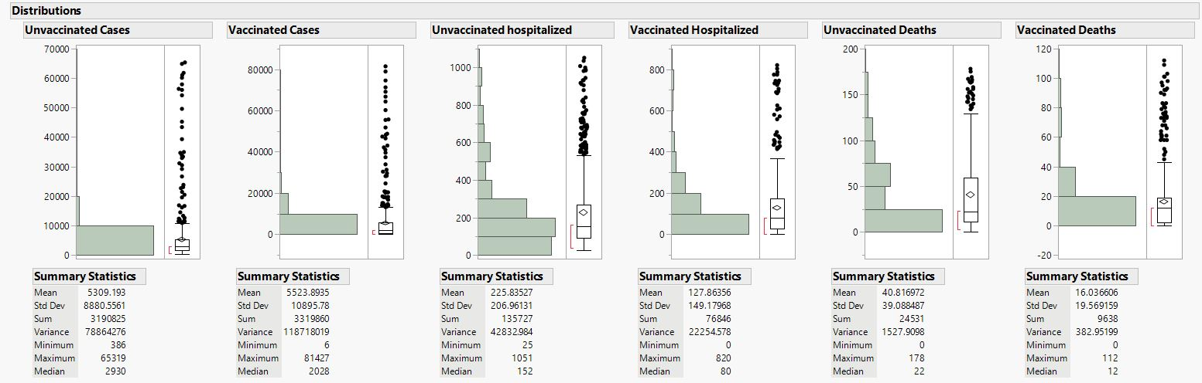
Data Description: Summary statistics of Vaccinated and Unvaccinated people (cases, hospitalized and deaths), Source: JMP
The mean is higher than the median for unvaccinated and vaccinated people in all stages (cases, hospitalized, and deaths), so the distribution is positively skewed.

Slide 5
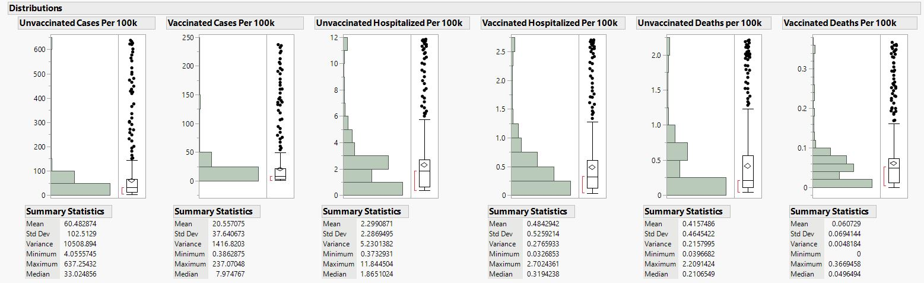
Summary statistics of Vaccinated and Unvaccinated rate per 100K (cases, hospitalized and deaths), Source: JMP
The mean of the Unvaccinated and vaccinated rate per 100K in all stages (cases, hospitalized, and deaths) is higher than the median, so the distribution is positively skewed. The median rate is considered instead of the mean rate as the difference between the mean and median rate is high.

Slide 6
Are unvaccinated people more hospitalized than the vaccinated?
The total number of people who received the Covid vaccine is less hospitalized than those who didn’t receive Covid vaccine in the year 2021.
But, from the following year, 2022, until the data from September, the scenario is the opposite: the total number of vaccinated people hospitalized is higher than the total number of unvaccinated people hospitalized. Their difference (6,155) is less than 2021 (65,036).

Slide 7
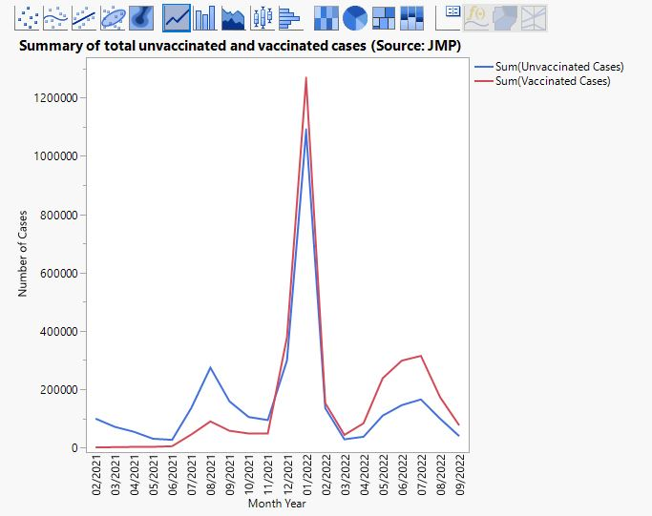
Are the number of unvaccinated cases larger than the vaccinated cased in terms of COVID-19 Positive?
The total number of vaccinated people with COVID positive was less than that of unvaccinated people with COVID positive until December 16, 2021. After that, vaccinated cases exceeded the total number of unvaccinated patients until September 2022.

Slide 8
Are the death numbers of unvaccinated higher than the vaccinated people?
In both 2021 and 2022, the total number of unvaccinated deaths is larger than the total number of vaccinated deaths.

Slide 9
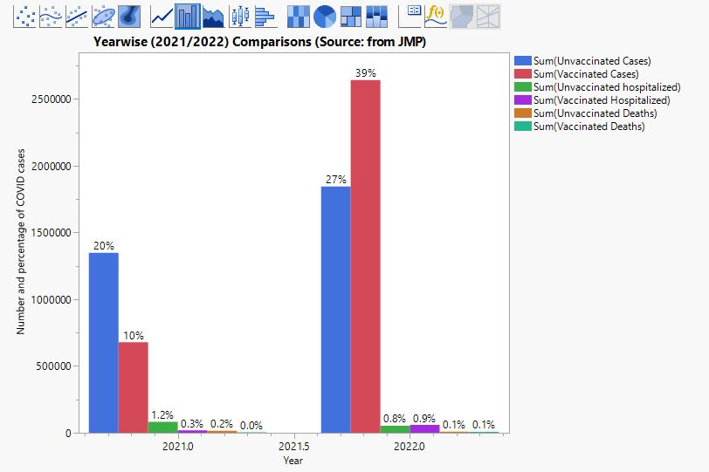
Are unvaccinated more than the vaccinated in terms of cases, hospitalized and deaths?
The overall summary states that from the mid of December 2021, the total numbers of vaccinated cases and vaccinated hospitalized are more significant than the total number of unvaccinated patients and hospitalized people.

Slide 10
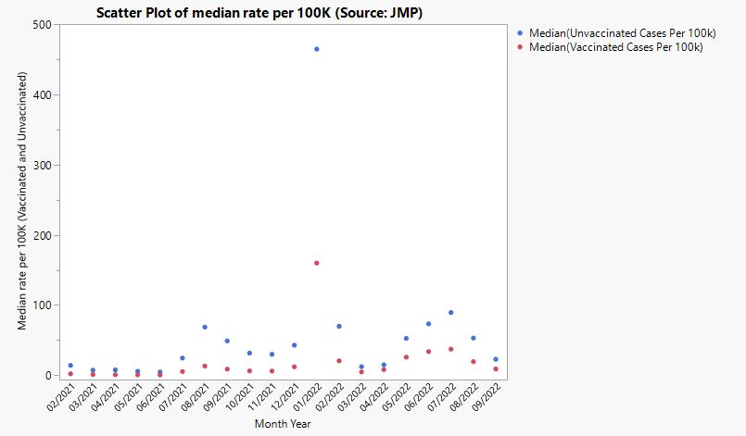
Comparison of unvaccinated and vaccinated median rate per 100K in terms of COVID-19 Positive
In both 2021 and 2022, the median rate of unvaccinated cases is more significant than that of vaccinated patients.

Slide 11
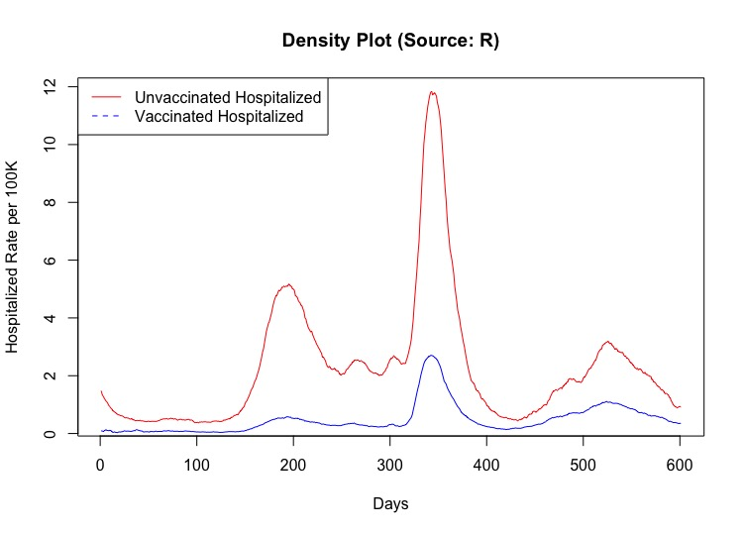
Comparison of unvaccinated and vaccinated hospitalized median rate per 100K
Referring to the density plot, the median hospitalized rate of unvaccinated is higher than that of vaccinated hospitalized.
The highest peak of the density plot for unvaccinated and vaccinated hospitalized median rate per 100k occurred on January 15, 2022.

Slide 12
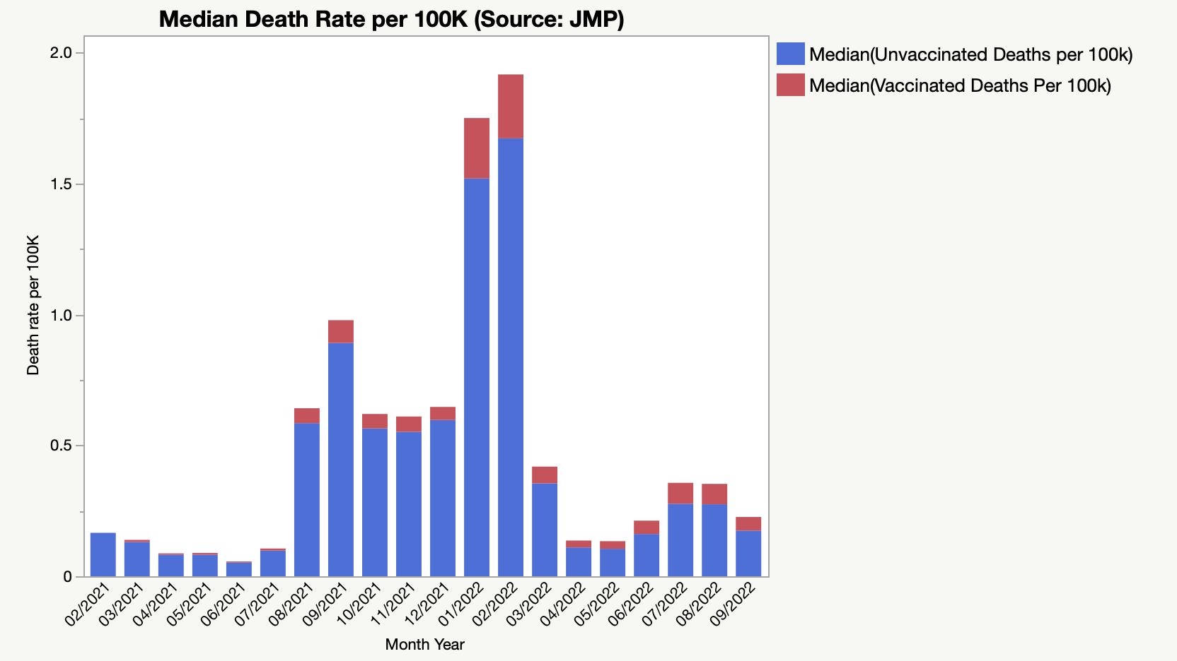
Comparison of unvaccinated and vaccinated death median rate per 100K
In both 2021 and 2022, the median death rate of unvaccinated is higher than that of vaccinated.

Slide 13
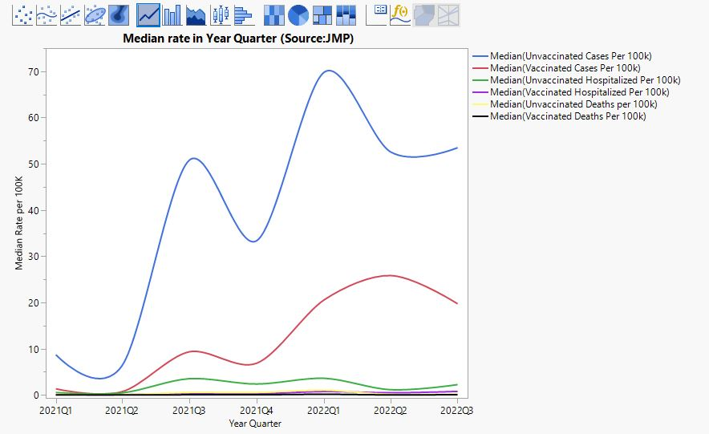
Overall summary of unvaccinated and vaccinated median rate per 100K in terms of cases, hospitalized and deaths
The overall summary indicates that in both 2021 and 2022, the median rate per 100K of unvaccinated is higher than the median rate of vaccinated in terms of cases, hospitalized, and deaths individually.

Slide 14
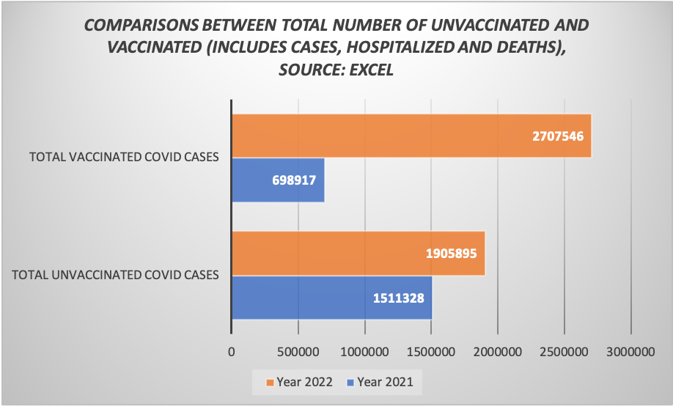
Comparison of the total number of unvaccinated and vaccinated people (includes the number of cases, hospitalized and deaths)
The total number of unvaccinated people is higher than the total number of vaccinated people in 2021.
But, from the following year, 2022, until the data from September, the scenario is the opposite: the total number of vaccinated people is higher than the total number of unvaccinated people.

Slide 15
Recommendations
The overall summary states that from the mid of December 2021, the total numbers of vaccinated cases and vaccinated hospitalized are more significant than the total number of unvaccinated patients and hospitalized people. This might create an effect on the Covid-19 vaccination campaign in the state of California. The California Department of Public Health (CDPH) needs to clarify the following questions regarding why these vaccinated people number is larger than the number of unvaccinated people in terms of cases and hospitalization numbers.
•Is it to ease the social gathering or the mask-wearing restrictions?
•Is it because of the new powerful Covid variants and so on?
Also, in this data set, CDPH can add the age group data, which will assist in identifying the number of people of different ages who, with no/minimal side impact after being vaccinated. Adding age groups to the data set will also enhance the Covid-19 vaccination campaign's success.

Slide 16
Conclusion
According to the CDC, the effectiveness of a vaccine is a measurement of how well it shields recipients from adverse effects like infection, illness, hospitalization, and death. With a few exceptions, the analysis of the Covid-19 post-vaccination data shows that those who have received the vaccine are less likely to spread an infection than those who have not. Common myths and rumors about the Covid-19 vaccine can be dispelled to ensure the effectiveness of the Covid-19 vaccination campaign. The CDPH has taken the initiative to determine the immunization status of Covid-19 cases, hospitalizations, and deaths.

Slide 17
ACKNOWLEDGEMENTS
At the very outset of this report, I extend my heartfelt gratitude to Dr. Daniel A. McGrath for his guidance and instructions in accomplishing this project. His operational advice, help, cooperation, and encouragement have fueled me to make headway in this project. Any omission in this brief acknowledgment does not constitute a lack of gratitude.

Slide 18
References
https://www.cdc.gov/museum/timeline/covid19.html
https://www.cdc.gov/coronavirus/2019-ncov/vaccines/different-vaccines/overview-COVID-19-vaccines.html#:~:text=After%20receiving%20U.S.%20Food%20and,15%20on%20July%208%2C%202022
https://www.cdc.gov/coronavirus/2019-ncov/vaccines/effectiveness/index.html
https://www.statista.com/statistics/1101932/coronavirus-covid19-cases-and-deaths-number-us-americans/
https://calmatters.org/newsletters/whatmatters/2021/01/health-care-workers-refuse-covid-vaccine-california/
https://data.chhs.ca.gov/dataset/covid-19-post-vaccination-infection-data

Slide 19
Thank You!
For Your Attention

